Slide 2
H O M E

Slide 3

H a I k u

Slide 4

H A I K U
-HOW TO PLAY-
There are 6 groups
Each member group must have 3 main words (season and things)
Write the main words in the board
Other group will make 3 sentences ( 5-7-5 syllables) using the main words in the piece of paper
After it is done, read it to everyone
Choose the best haiku by voting
Spring morning marvel
Lovely nameless little hill
On a sea of mist
- Basho

Slide 5


Sonnet
& monologue poem
BY : NI PUTU AYU PUSPA YULIANDARI

Slide 6
LEARNING OBJECTIVES
Students are able to differentiate sonnet and dramatic monologue poem based on the features.
Students are able to analyze the characteristics of sonnet and dramatic monologue poem properly.

Slide 7
SONNET
MONOLOGUE POEM

Slide 8
S O N N E T

Slide 9
SONNET
One type of poems which has features:
14 lines broken down into 4 sections called quatrains
A strict rhyme scheme
Written in iambic pentameter

Slide 10
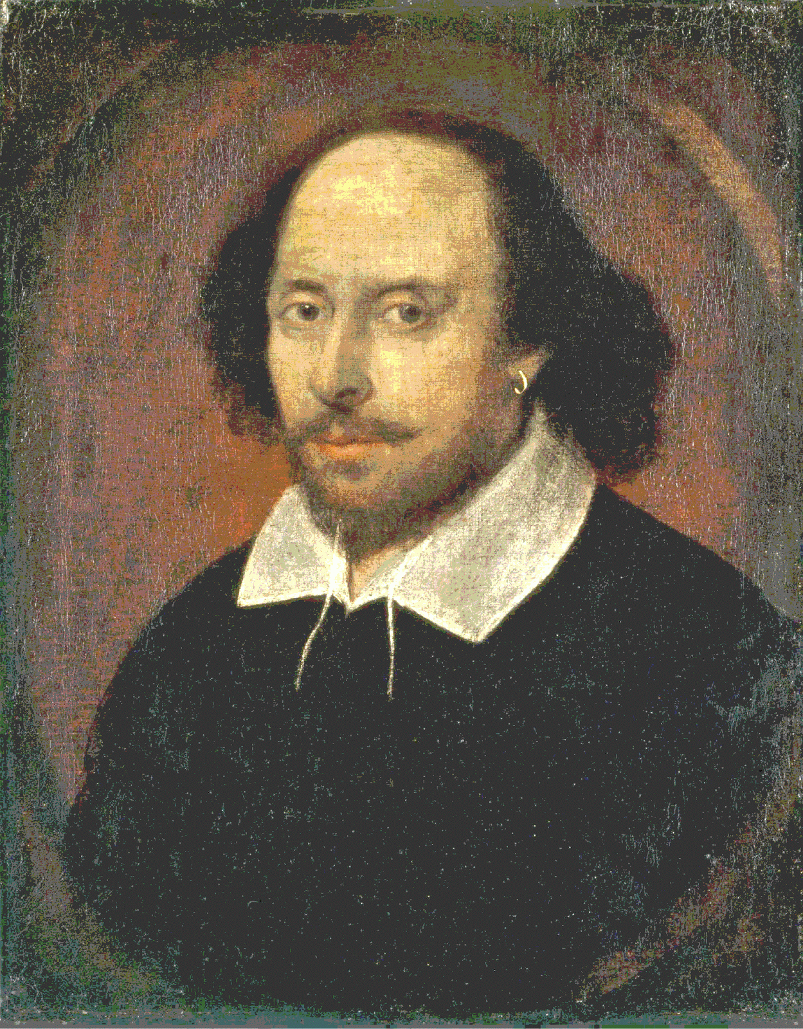
William Shakespeare
(26 April 1564 – 23 April 1616)
Poet – Playwright – Actor

Slide 11
ESSENTIAL ENGLISH
PP 243
“SONNET XVIII”

Slide 12
Sonnet 18: Shall I compare thee to a Summers day?
Shall I compare thee to a Summers day?
Thou art more lovely and more temperate:
Rough winds do shake the darling buds of May,
And Sommers lease hath all too short a date:
Sometime too hot the eye of heaven shines,
And often is his gold complexion dimm’d,
And every faire from faire some-time declines,
By chance, or natures changing course untrimm’d:
But thy eternal Sommer shall not fade,
Nor loose possession of that faire thou ow’st,
Nor shall death brag thou wandre’st in his shade,
When in eternal lines to time thou grow’st,
So long as men can breath or eyes can see,
So long lives this, and this gives life to thee,

Slide 13
Sonnet 18: Shall I compare thee to a Summers day?
Shall I compare thee to a Summers day?
Thou art more lovely and more temperate:
Rough winds do shake the darling buds of May,
And Sommers lease hath all too short a date:
Sometime too hot the eye of heaven shines,
And often is his gold complexion dimm’d,
And every faire from faire some-time declines,
By chance, or natures changing course untrimm’d:
But thy eternal Sommer shall not fade,
Nor loose possession of that faire thou ow’st,
Nor shall death brag thou wandre’st in his shade,
When in eternal lines to time thou grow’st,
So long as men can breath or eyes can see,
So long lives this, and this gives life to thee,

Slide 14
Sonnet 18: Shall I compare thee to a Summers day?
Shall I compare thee to a Summers day?
Thou art more lovely and more temperate:
Rough winds do shake the darling buds of May,
And Sommers lease hath all too short a date:
Sometime too hot the eye of heaven shines,
And often is his gold complexion dimm’d,
And every faire from faire some-time declines,
By chance, or natures changing course untrimm’d:
But thy eternal Sommer shall not fade,
Nor loose possession of that faire thou ow’st,
Nor shall death brag thou wandre’st in his shade,
When in eternal lines to time thou grow’st,
So long as men can breath or eyes can see,
So long lives this, and this gives life to thee,
1st quatrain : 4Rhyme ABAB
States the subject of sonnet
2nd quatrain : 4Rhyme CDCD
Develops the sonnet’s theme
3rd quatrain : 4Rhyme EFEF rounds off the sonnet’s theme
4th quatrain : 4Rhyme GG serves as a conclusion to the sonnet

Slide 15
M o n o l o g u e p o e m

Slide 16
FORM OF DRAMATIC POETRY
Soliloquy
Speaks to himself/herself and shows his/her ideas
Dramatic Monologue
Talks to someone else in the play even the second character does not say anything. It makes the dialogue more believable.
Character Sketch
Creates emotional connection to the audience

Slide 17
MONOLOGUE POEM
Narrates a story
Emotions or behavior
A set rhyming or meter pattern
Typically ends up feeling very rhythmic
The speech and actions to depict a scene or plot
The point of view of the character
Action through Facial expression, gestures, or interaction with other people or things
Acting by physical performance, spoken, or sung

Slide 18
ESSENTIAL ENGLISH
PP 243-245
“LAST DUCHESS”

Slide 19
ESSENTIAL ENGLISH
PP 250
“MARY MAGDALENE”

