Slide 2
GUESSING
JILL’S ROUTINES

Slide 3
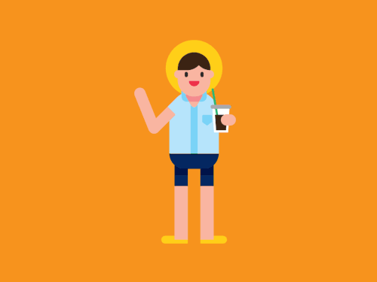
Hello! My name is Jill.
I am a 9-Grade student. I love English
and soda.
Do you want to play a game with me?
You need to guess my EVERYDAY routines!
HOW TO PLAY
START

Slide 4
HOW TO PLAY
You will work in group.
You will guess Jill’s routines through several pictures.
Please guess it in a full sentence.
If you want to answer the question, a representative of group must raise the hand.
Collect point as many as possible and you will be the winner
Team work is the key!
BACK
START

Slide 5


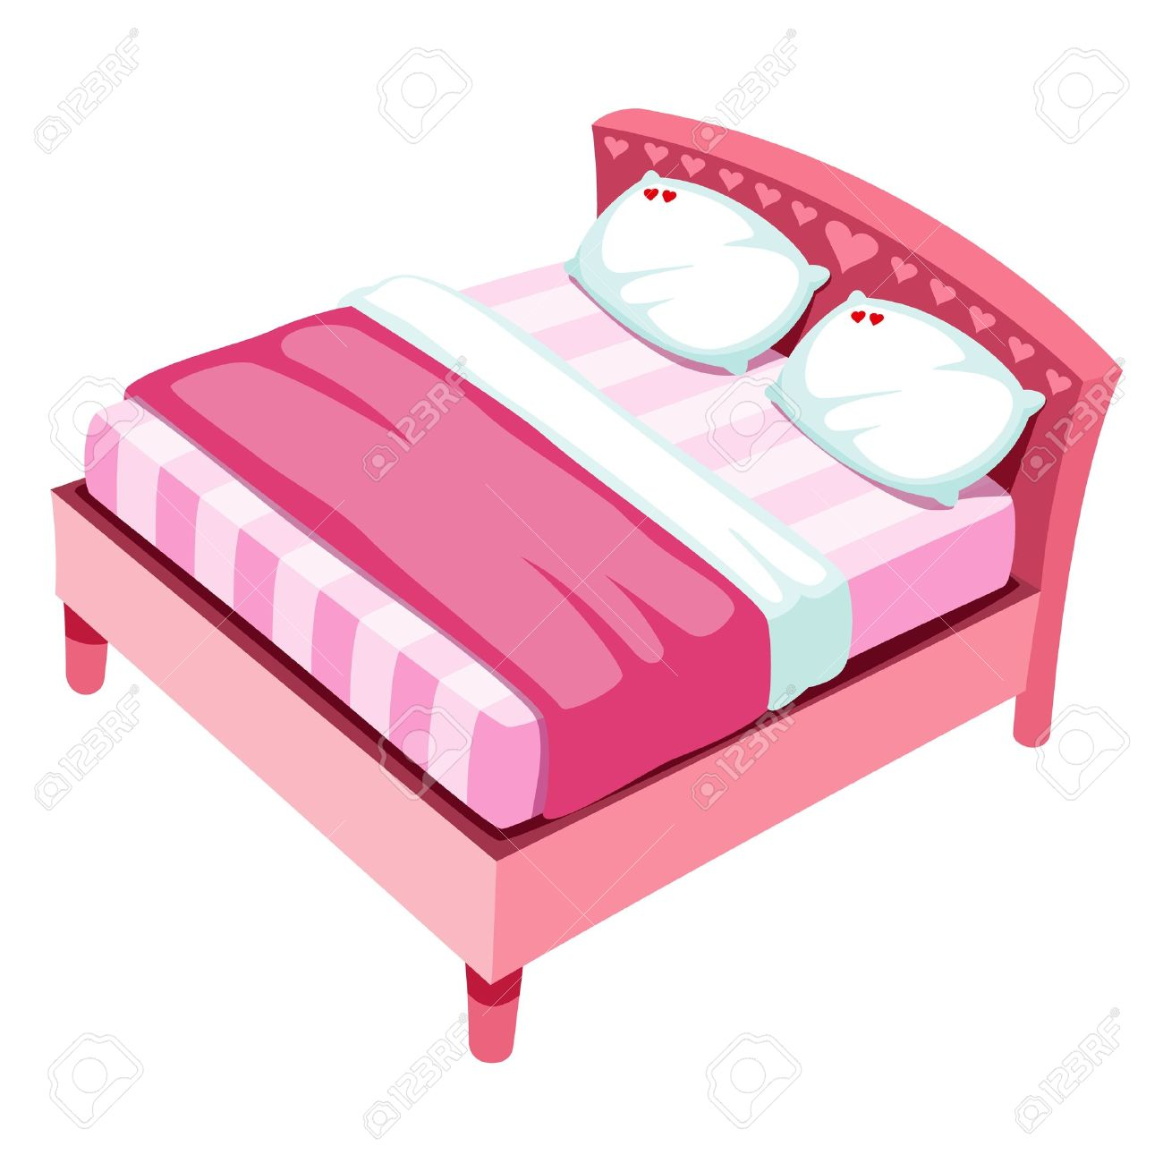
5:00
Jill always wakes up at 5 am in the morning

Slide 6
Are you ready?

Slide 7
Go!!

Slide 8

6:30
Jill always goes to school at 6:30 in the morning

Slide 9

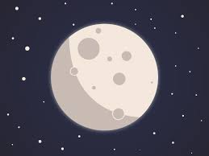
Jill always reads a book in the evening

Slide 10
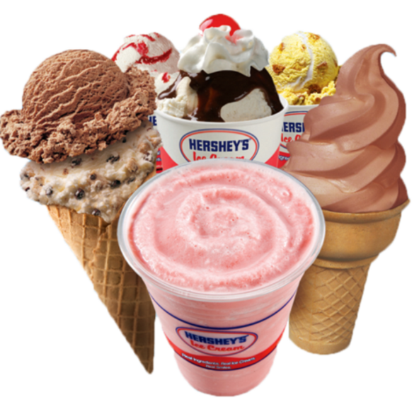
Jill never eats ice cream in the evening

Slide 11
10:00
Jill always goes to be at 10 pm in the evening

Slide 12

6
SAT
Jill always plays basketball in Saturday morning

Slide 13
Final round

Slide 14
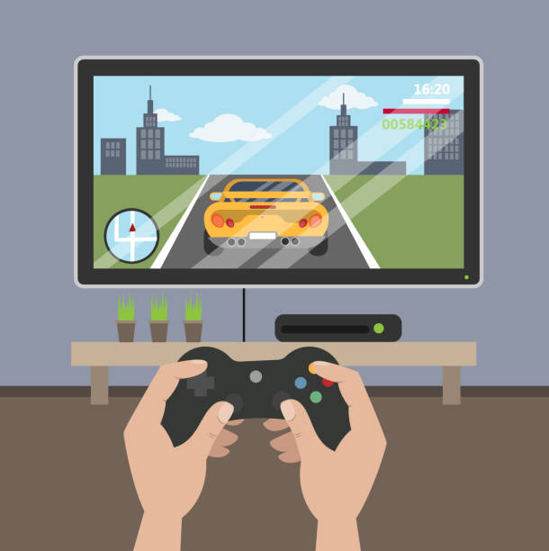
7
SUN
Jill always plays a game in Sunday morning

Slide 15
YEAY!!!
Congrats for the winner!
Thank you and see you again.
HOME
PLAY AGAIN

Slide 16
ADVERBS
BY: NI PUTU AYU PUSPA YULIANDARI

Slide 17
LEARNING OBJECTIVES
Students are able to know types of adverbs
Students are to apply the use of adverbs in form of sentences
Students are able to create a story which contains adverbs

Slide 18
WHAT IS ADVERB ??
Adverb is a word that modifies a verb, adjective, another adverb, phrase, clause, or sentence.

Slide 19
WHAT IS ADVERB ??
The position of adverb can be in the beginning, after main verb, or end of a sentence
Now, they are coming.
I ran quickly than before.
We will go to Japan tomorrow.

Slide 20
FREQUENCY
NEGATION
MANNER
PLACE
REASON
DEGREE
TIME
TYPES OF ADVERBS

Slide 21
ADVERB OF FREQUENCY
Adverbs of frequency explain how often the verb occurs.

Slide 22
ALWAYS
I always wash my hands before eating.
USUALLY
I usually bring my lunch to the school.
NORMALLY
I normally get good score in math.
OFTEN
I often play game after studying.
SOMETIMES
I sometimes eat apple pie.
OCCASIONALLY
I occasionally go to USA.
SELDOM
I seldom wear makeup.
RARELY
I rarely buy toys.
NEVER
I never go to LA.

Slide 23
ADVERB OF NEGATION
Adverb of negation declares something or information in negative statement.

Slide 24
NEVER
I never meet Justin Bieber in real life.
NO
NOT
I am not going to outside.
ANY
There is any gold in this bank.
There is no ice cream in our party

Slide 25
ADVERB OF MANNER
Adverb of manner provides more information about how a verb is done.
Most of them will end in -ly

Slide 26
QUICKLY
She walked quickly.
SOFTLY
Our mother spoke softly to us.
LOUDLY
They laughed loudly and it was noisy.
BEAUTIFULLY
Nana dances the ballet beautifully.
FAST
He offers the salt fast.

Slide 27
ADVERB OF TIME
Adverb of time provides more information about when a verb takes place.

Slide 28
SOMETIMES
Sometimes she walks from her house to the school.
YESTERDAY
I watched Home Alone movie yesterday.
LATER
We will talk this problem later.
NOW
Now you can leave the room.
DURING
She is always eating during the party.

Slide 29
ADVERB OF DEGREE
Adverb of degree explains the level or intensity of a verb, adjective, or another adverb.

Slide 30
ALMOST
She almost win the game.
ENOUGH
I don’t have enough money.
SO
We are so excited to watch their new movie!
TOO
Can I have the cake too?

Slide 31
ADVERB OF PURPOSE / REASON
Adverb of purpose or reason explains the other clause (dependent clause) by adding subordinating conjunctions.

Slide 32
BECAUSE
I can’t go to school because I’m sick.
THAT
I am glad that you win the game
AS
As he was not here, I left a gift to his mother.

Slide 33
ADVERB OF PLACE
Adverb of place illustrates where the verb is happening.

Slide 34
EVERYWHERE
I can find many roses everywhere in this town.
NEARBY
We built a house nearby the park.
OUTSIDE
They play basketball outside.
ON
She left the cake on the table.
AROUND
We ran around the park.
THERE
My mom fell the cake at there.

Slide 35
LET’S EXERCISE!

Slide 36
I always walk to go to school.
We watched Resident Evil yesterday.
I don’t have enough time to complete the quiz.
No cake left because she ate it yesterday.
We can’t go to Japan because we have a meeting.
I never go to USA but hopefully I can go there someday.
She eats her dinner quickly than usual.
It is raining outside.
I hate thunder very much.
You will find the pamphlet around the school.
Yesterday Always Because Never Quickly
Very Around Enough Outside No

Slide 37
WORD SEARCH

Slide 38
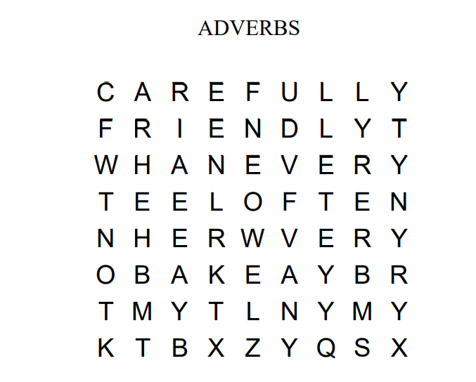
WORD SEARCH
-
-
-
-
-
-
-
-
-
-

Slide 39
WORD SEARCH
CAREFULLY
FRIENDLY
NEVER
OFTEN
VERY
ALWAYS
HERE
WEEKLY
THAT
NOT

Slide 40
THANK YOU

