Slide 2
H O M E

Slide 3

CLASSROOM
CONNECTIONS

Slide 4
HOW TO PLAY
There are six groups
There are two rounds (person and thing)
Each member of a group need to describe the topic without saying the name.
Other group will guess who/what is it in 20 seconds.
Every group who can guess it correctly will get 3 points and who cannot guess it will get 2 point.

Slide 5
ROUND
1

Slide 6
ROUND
2

Slide 7

WELL DONE!

Slide 8


pronouns
BY: NI PUTU AYU PUSPA YULIANDARI

Slide 9
LEARNING
OBJECTIVES
Students are able to know types of pronouns.
Students are able to apply the use of pronouns in form of sentences.
Students are able to create a story which contains of pronouns.

Slide 10
PRONOUNS
A word used as a substitute for a noun to avoid repetition of the same noun.
Personal
Demonstrative
Indefinite
Relative
Interrogative

Slide 11
Peter sees Peter in the mirror and Peter says, “Peter, Peter is awesome. Never let people tease Peter! People never know Peter life as well as Peter. Always love Peter”. Then Peter smiles.

Slide 12
Peter sees Peter (himself) in the mirror and Peter (he) says, “Peter, Peter is (You are) awesome. Never let people tease Peter (you)! People (They) never know Peter (your) life as well as Peter (yourself). Always love Peter (yourself) ”. Then Peter (he) smiles.

Slide 13
PERSONAL PRONOUNS
Personal
Indefinite
Relative
Interrogative
Demonstrative
Stand directly for names of persons, places, things, and ideas

Slide 14
PERSONAL
PRONOUNS
SUBJECT PERSONAL PRONOUNS
Replace the subject of the sentence
  Peter is rich. He has a cruise ship.
  I never go to London.
OBJECT PERSONAL PRONOUNS
Take place as object of the sentence
  I met her at the school yesterday.
  They will help you.

Slide 15
I cannot bring this chair. Can you help me ?
Do you know BTS? I saw them in town yesterday. They are awesome.
It is raining.
My Mom, My Daddy and I go to the cinema. We will come after the lunch.
Nana is a student. She is in 10 grade at Rosario Institute.
Kyle and Kyla are my sisters. They are twins.
My mom always serves papaya as the dessert. I do not like it.
I cannot find Yui in the class. Can you give this book to her ?

Slide 16
Demonstrative pronouns
Personal
Indefinite
Relative
Interrogative
Demonstrative
Point definitely to persons, things, or concepts to they refer.

Slide 17
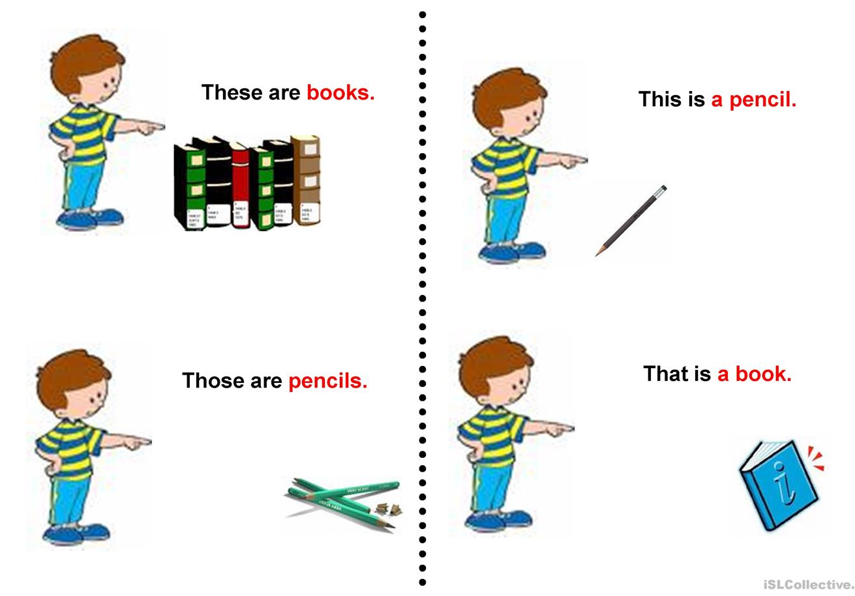
Demonstrative pronouns
- THAT -
refer to singular nouns which are FAR
- THESE -
refer to plural nouns which are NEAR
- THOSE -
refer to plural nouns which are FAR
- THIS -
refer to singular nouns which are NEAR

Slide 18

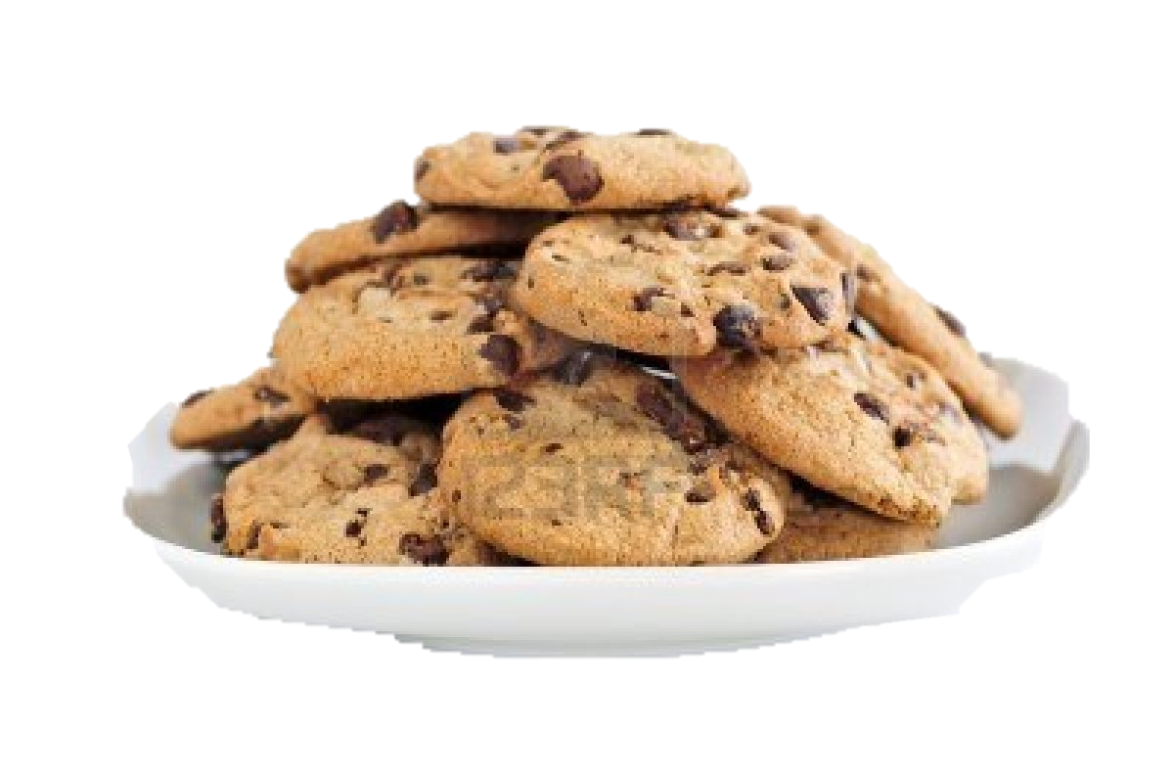

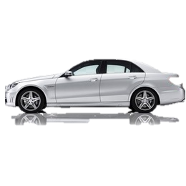
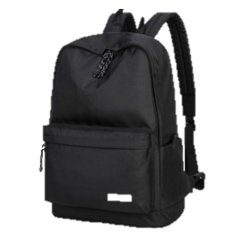
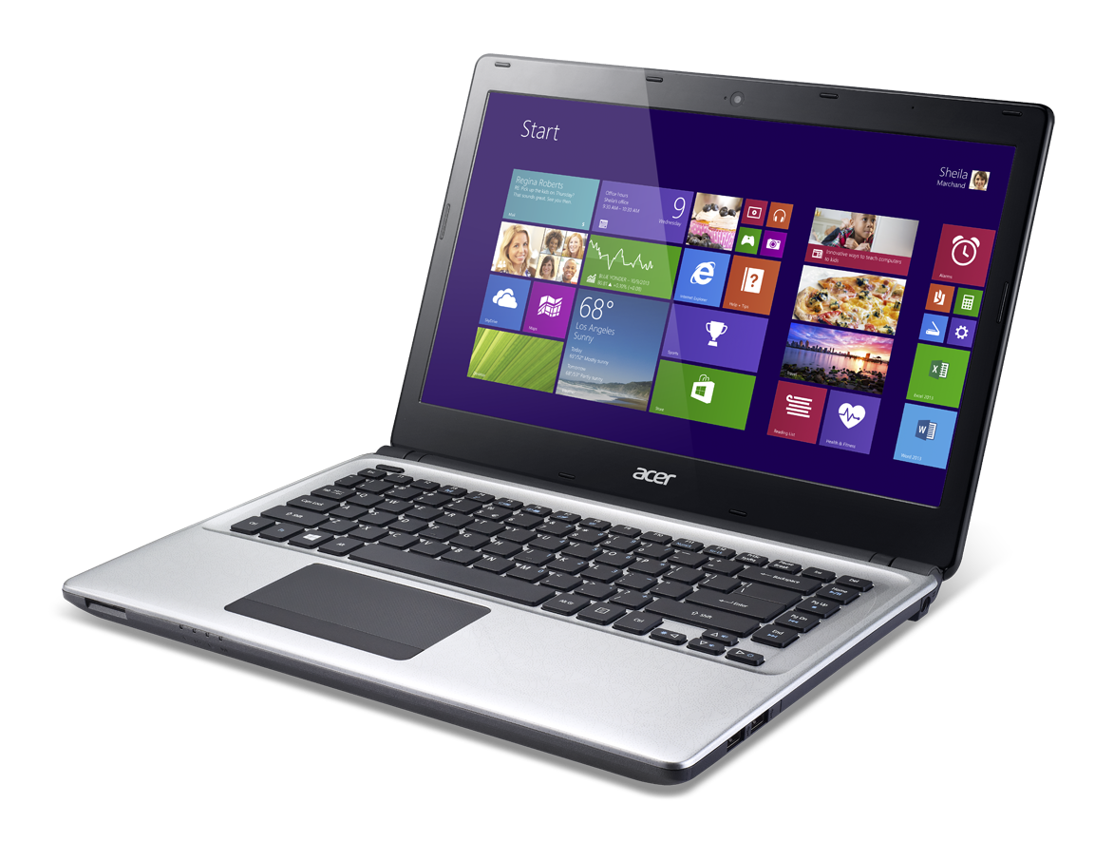

These are cookies
Those are ice creams
1
5
That is a car
2
This is a laptop
3
This is a bag
6
Those are books
4

Slide 19
Indefinite pronouns
Personal
Indefinite
Relative
Interrogative
Demonstrative
Point out to people, place, things, or concept without saying exactly who or what

Slide 20
Indefinite pronouns
PRONOUN | MEANING | EXAMPLE
Anybody / Anyone | An additional or different person | Can anyone answer this questions?
Everybody / Everyone | All people | Everybody will come to the meeting.
Somebody / Someone | An unspecified or unknown person | I saw someone in his car last night.
Nobody / No one | No person | Nobody came to the school.

Slide 21
Indefinite pronouns
PRONOUN | MEANING | EXAMPLE
Anything | No matter what person | She will give anything for getting her phone back.
Everything | All things | She eats everything in Peter’s party.
Something | An unspecified or unknown thing | He brings something inside his bag.
Nothing | No single thing | I open the box but it is nothing.

Slide 22
Indefinite pronouns
PRONOUN | MEANING | EXAMPLE
Each | Every one of two or more things | I never meet each of them
Either | One or the other of two people or things | I cannot choose between pie and cake. Either is delicious.
Neither | Not one or the other of two people or things | They ask me to buy fish and chicken but I don’t like neither.

Slide 23
Indefinite pronouns
PRONOUN | MEANING | EXAMPLE
Both | Two people or things, seen together | Both of red dresses are good. I like it.
Few | A small number of people or things | We left few books in the room.
Many | A large number of people or things | Many people are watching Home Alone
Several | More than two but not many | There are several students in the class.
Others | Other people; not us | Others will attend to our party.

Slide 24
There is something in your hair. I think it is a petal.
My book was on the desk. Somebody has taken it.
Everything we did to rescue the dog was useful. It saved.
The police found the murder weapon somewhere near the hut.
He is so kind. He always greets everybody in the school.
Don’t blame yourself for the mistake. Nobody is perfect.
I never know both of you are twins.
She will meet the others in the room. We can go out.
Don’t ask me to choose apple or grape. Neither are bad for me.
Many people will celebrate CNY in town tomorrow.

Slide 25
Relative pronouns
Personal
Indefinite
Relative
Interrogative
Demonstrative
Refer to antecedents, at the same time, introduce dependent clauses.

Slide 26
Relative pronouns
WHO
Apply to person
Eric who won the tournament last year will be the judge for the next tournament.
WHOM
Apply to person as the object pronoun
The girl whom we invite is Lara’s sister.
WHOSE
Apply to person as the possessive form of WHO
Peter is a boy whose the essay gets compliment from the principal.

Slide 27
Relative pronouns
WHICH
Apply to things
Clara always brings her phone which she got from her brother.
THAT
Apply to either person or things
The musician that won the award is Canadian.

Slide 28
I talked to the girl whose car had broken down in front of the shop.
Mr. JK, who is a doctor, lives on the corner.
I live in a house in Norwich which is in East Anglia.
This is the boy who comes from USA.
Thank you very much for your email which was very interesting.
The girl, whose father is a professor, forgot her books.
The car that Jason bought yesterday was expensive.
The girl whom they greet is the new principal.
Jessica brings her new bag that she gets from giveaway event.
The boys who sing Idol are BTS.

Slide 29
INTERROGATIVE pronouns
Personal
Indefinite
Relative
Interrogative
Demonstrative
Ask fact questions

Slide 30
INTERROGATIVE pronouns
WHO
WHOM
Apply to person as object
Who is in the class?
Whom are you going to invite?
WHOSE
Apply to person as possessive form
Whose phone is this?
WHAT
Apply to things
What do you want for you dinner?
WHICH
Apply to persons or things
Which is your bag?
Apply to person as subject

Slide 31
What did you do then?
Who is knocking at the door?
What would you like to eat?
By whom was this book written?
Which one is better? Rice or pasta?
Whose jacket is this?

Slide 32
Pronoun card for a story

Slide 33
How to Play
Students will work with previous group in the classroom connections.
Each group will choose 2 cards.
They should make at least 2 sentences for 1 pronoun card.
Every group will write their sentences by turns with other groups.
The sentences must be coherent and it will be a story.

Slide 34
THIS
SOMEONE
WHO
I
1
2
3
4
NOTHING
WHICH
THEY
WHAT (?)
5
6
7
8
THAT
MY
HIM
NEITHER
9
10
11
12

Slide 35
Essential English pp. 302-303

Slide 36
Please write a story about your last holiday.
It must be:
Including 5 types of pronouns
Underlining the pronouns
Analyzing the pronoun
At least 2 paragraph
In form of type writing/printed writing

